Slide 1
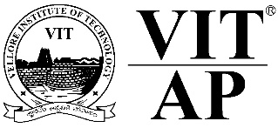
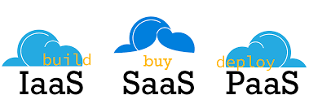
Course code : CSE4001 Course title : Cloud Computing Module : 5 Topic : 2
Cloud Delivery Models

Slide 2
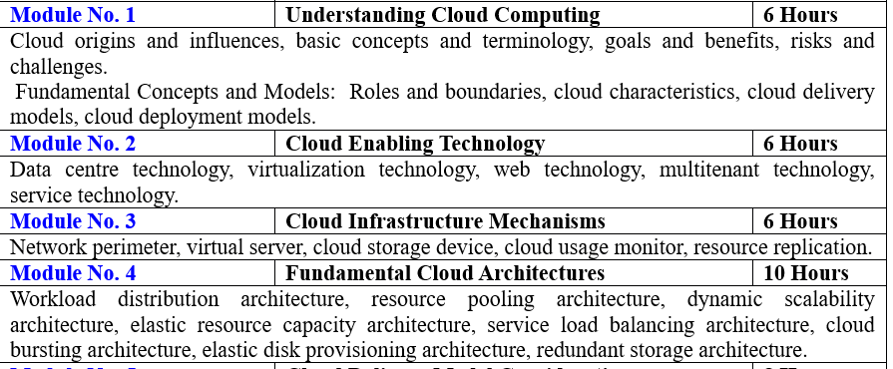

Slide 3
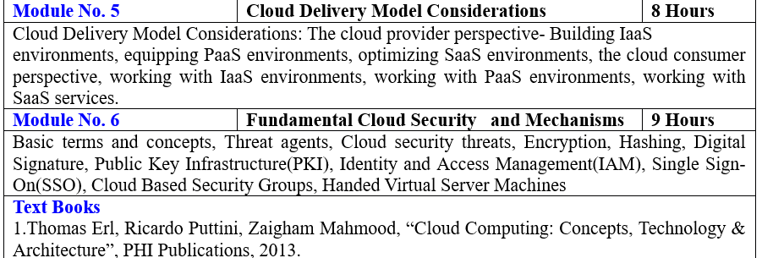

Slide 4
Objectives
This session will give the knowledge about
14.1 Cloud Delivery Models: The Cloud Provider Perspective
14.2 Cloud Delivery Models: The Cloud Consumer Perspective
14.3 Case Study Example

Slide 5
The Cloud Provider Perspective
Building IaaS Environments
Equipping PaaS Environments
Optimizing SaaS Environments
The Cloud Consumer Perspective
Working with IaaS Environments
Working with PaaS Environments
Working with SaaS Services

Slide 6
This section raises various considerations concerning the different ways in which cloud delivery models are administered and utilized by cloud consumers.

Slide 7
Cloud Consumer ?
The cloud consumer is the principal stakeholder for the cloud computing service. A cloud consumer represents a person or organization that maintains a business relationship with, and uses the service from a cloud provider.
The cloud consumer may be billed for the service provisioned, and needs to arrange payments accordingly.
Cloud consumers need SLAs to specify the technical performance requirements fulfilled by a cloud provider. SLAs can cover terms regarding the quality of service, security, remedies for performance failures.

Slide 8
Working with IaaS Environments
Virtual servers are accessed at the operating system level through the use of remote terminal applications. Accordingly, the type of client software used directly depends on the type of operating system that is running at the virtual server, of which two common options are:
Remote Desktop (or Remote Desktop Connection) Client – for Windows-based environments and presents a Windows GUI desktop.
SSH Client – for Mac and other Linux-based environments to allow for secure channel connections to text-based shell accounts running on the server OS

Slide 9
Typical usage scenario for virtual servers at are being offered as IaaS services

Slide 10
A cloud storage device can be attached directly to the virtual servers and accessed through the virtual servers’ functional interface for management by the operating system.
Alternatively, a cloud storage device can be attached to an IT resource that is being hosted outside of the cloud, such as an on-premise device over a WAN or VPN.
In these cases, the following formats for the manipulation and transmission of cloud storage data are commonly used:

Slide 11
•Networked File System – System-based storage access, whose rendering of files is similar to how folders are organized in operating systems (NFS, CIFS)
•Storage Area Network Devices – Block-based storage access collates and formats geographically diverse data into cohesive files for optimal network transmission (iSCSI, Fibre Channel)
•Web-Based Resources – Object-based storage access by which an interface that is not integrated into the operating system logically represents files, which can be accessed through a Web-based interface (Amazon S3)

Slide 12
IT Resource Provisioning Considerations
Cloud consumers have a high degree of control over how and to what extent IT resources are provisioned as part of their IaaS environments.
For example:
•controlling scalability features (automated scaling, load balancing)
•controlling the lifecycle of virtual IT resources (shutting down, restarting, powering up of virtual devices)

Slide 13
•controlling the virtual network environment and network access rules (firewalls, logical network perimeters.
•establishing and displaying service provisioning agreements (account conditions, usage terms)
•managing the attachment of cloud storage devices
•managing the pre-allocation of cloud-based IT resources (resource reservation)
•managing credentials and passwords for cloud resource administrators

Slide 14
• managing credentials for cloud-based security groups that access virtualized IT resources through an IAM
•managing security-related configurations
•managing customized virtual server image storage (importing, exporting, backup)
•selecting high-availability options (failover, IT resource clustering)
•selecting and monitoring SLA metrics

Slide 15
•selecting basic software configurations (operating system, pre-installed software for new virtual servers)
•selecting IaaS resource instances from a number of available hardware-related configurations and options (processing capabilities, RAM, storage)
•selecting the geographical regions in which cloud-based IT resources should be hosted
•tracking and managing costs

Slide 16
The management interface for these types of provisioning tasks is usually a usage and administration portal, but may also be offered via the use of command line interface (CLI) tools that can simplify the execution of many scripted administrative actions.
Even though standardizing the presentation of administrative features and controls is typically preferred, using different tools and user-interfaces can sometimes be justified. For example, a script can be made to turn virtual servers on and off nightly through a CLI, while adding or removing storage capacity can be more easily carried out using a portal.

Slide 17
Summary
Optimizing SaaS –Offering, Monitoring Usage and Secuirty
Consumer Perspective:
Working with IaaS
IT Resource Provisioning Considerations

Slide 18
Thank You!

Slide 19
Reference
https://timesofcloud.com/cloud-tutorial/cloud-providers/

Slide 20
Next Class
Cloud Delivery Models: The Cloud Consumer Perspective

